Slide 1
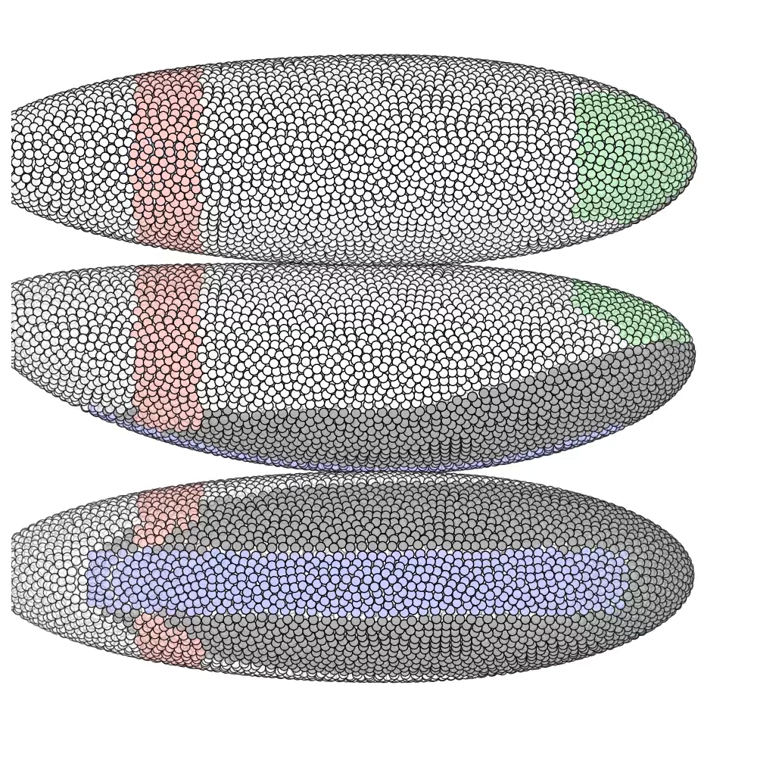
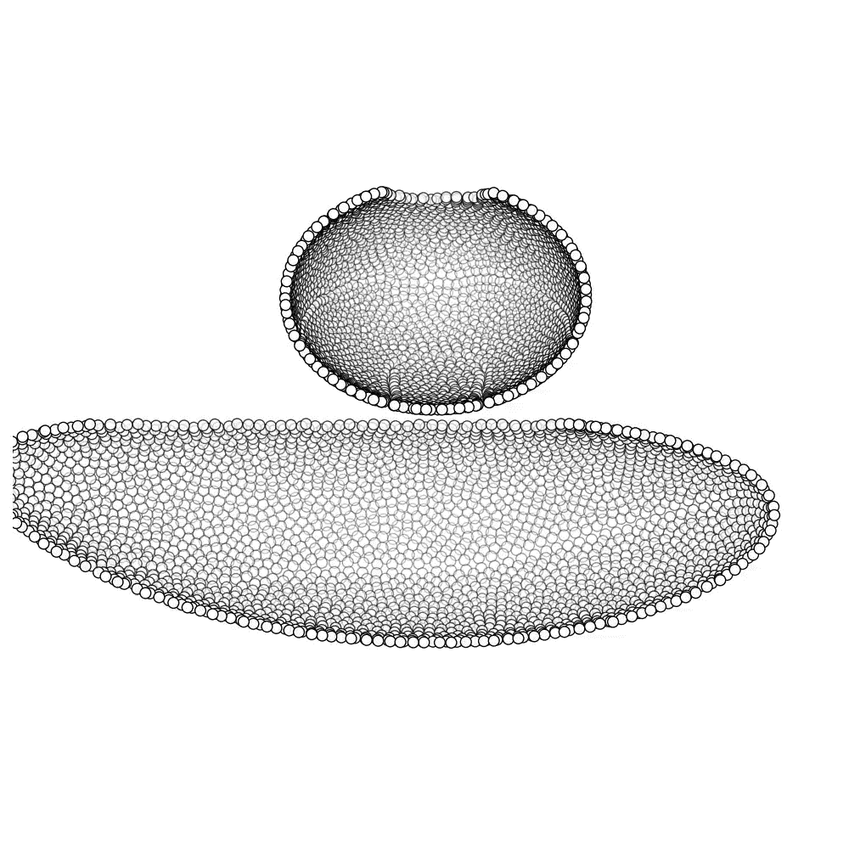

Slide 2
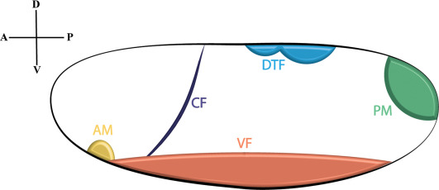
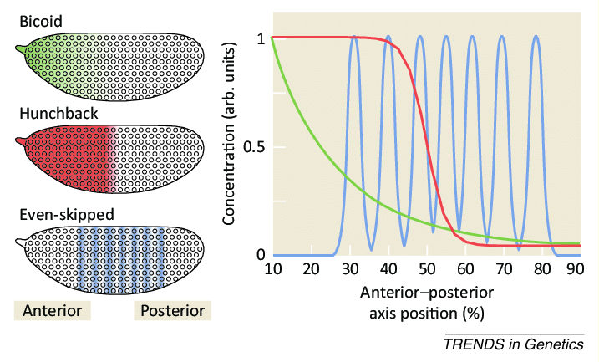
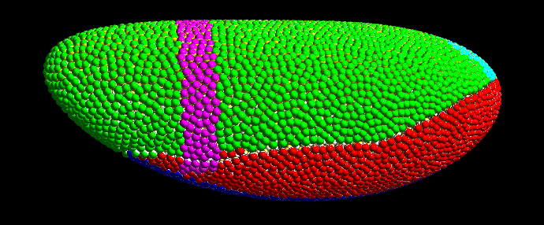
Boundary- and initial condition
Implementation of genetic expression

Slide 3
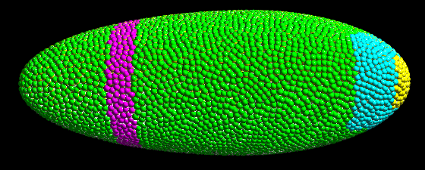


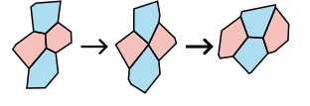
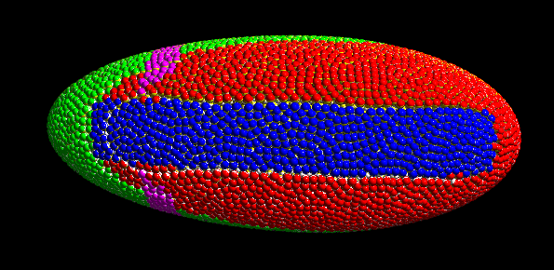
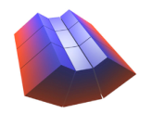

Slide 4
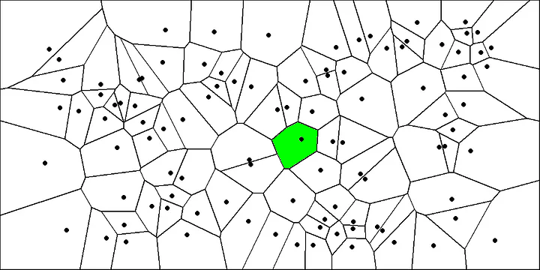

Slide 5
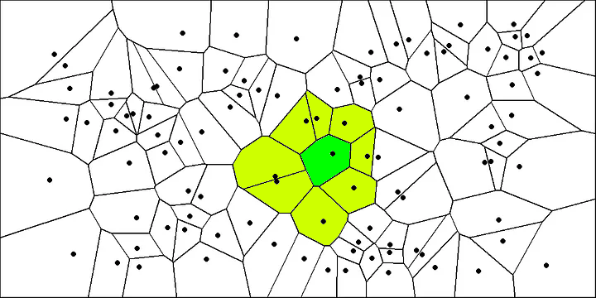

Slide 6
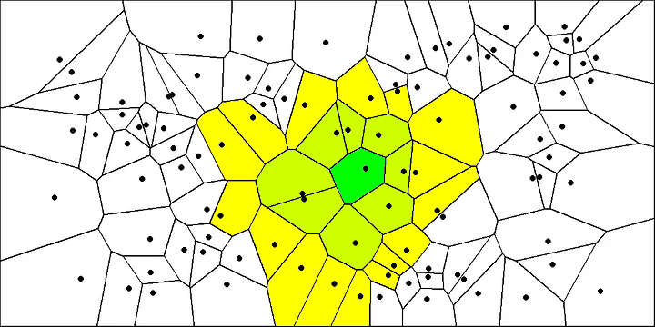

Slide 7
Our model
These are its polarities
This is a cell
Through their interaction we define a potential
This is another cell

Slide 8
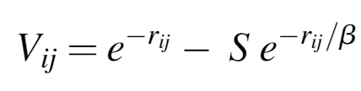
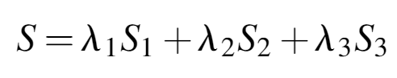
The potential

Slide 9
The potential
Is AB-polarity aligned and perpendicular to distance?

Slide 10
The potential
Is AB-polarity aligned and perpendicular to distance?

Slide 11
The potential
Is AB-polarity aligned and perpendicular to distance?
Are ABP and PCP aligned and at right angles?

Slide 12
The potential
Is AB-polarity aligned and perpendicular to distance?
Are ABP and PCP aligned and at right angles?

Slide 13
The potential
Is AB-polarity aligned and perpendicular to distance?
Is PCP aligned and perpendicular to distance?
Are ABP and PCP aligned and at right angles?

Slide 14
The potential
Is AB-polarity aligned and perpendicular to distance?
Is PCP aligned and perpendicular to distance?
Are ABP and PCP aligned and at right angles?

